Slide 1
High Speed Drill calibration A deep learning approach
Clement Wang
clementwang2001@gmail.com
Supervisor: Christian Koch christian.koch@stryker.com

Slide 2
Summary: I. Problem statement II. Pipeline overview III.2D Key points detection IV. Triangulation V. Future works

Slide 3
Problem statement
Accelerating instrument calibration
from 2 minutes to 10 seconds

Slide 4
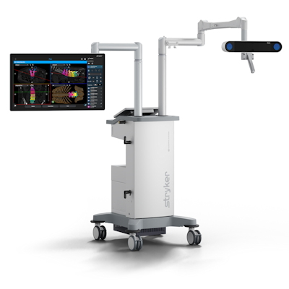
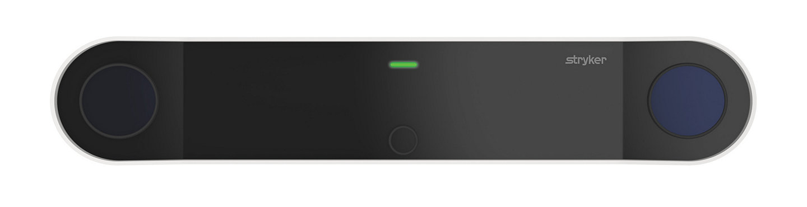
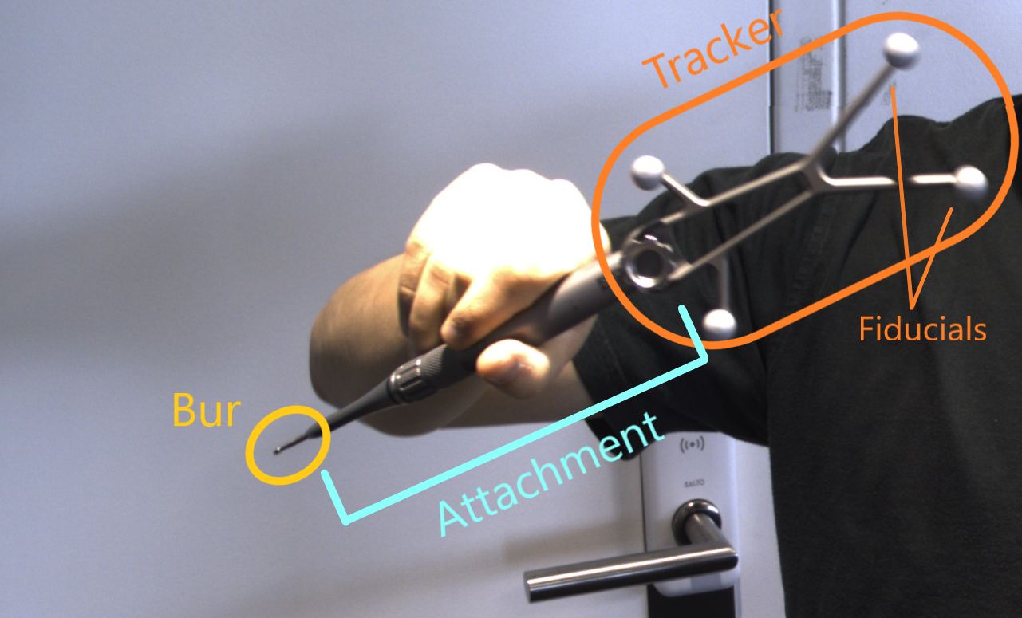
I. Introduction of the context
NIR Cameras
RGB Camera
Track the surgery instruments to ensure safety
Provide guidance during the surgery
Navigation system
FP8000 camera
High speed drill instrument

Slide 5
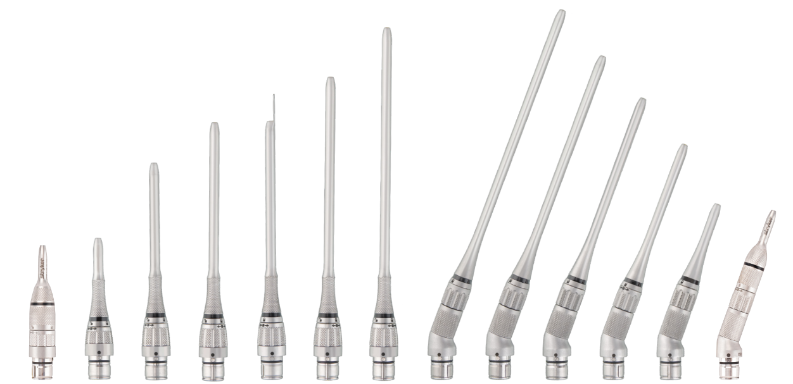
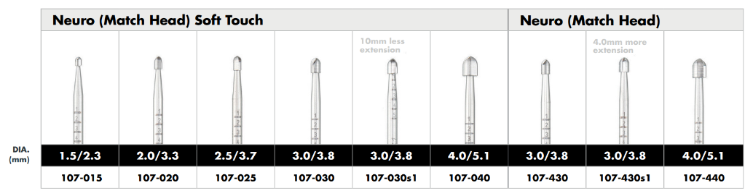
I. Problem definition
3D positions are tracked through tracker-to-tip 3D transformation
Getting this transformation requires manual calibration and is repetitive and time-consuming (up to 2 minutes)
Results of the internship: Accelerate the calibration from 2 minute to 10 seconds

Slide 6
II. How does it work?
A deep learning based approach

Slide 7
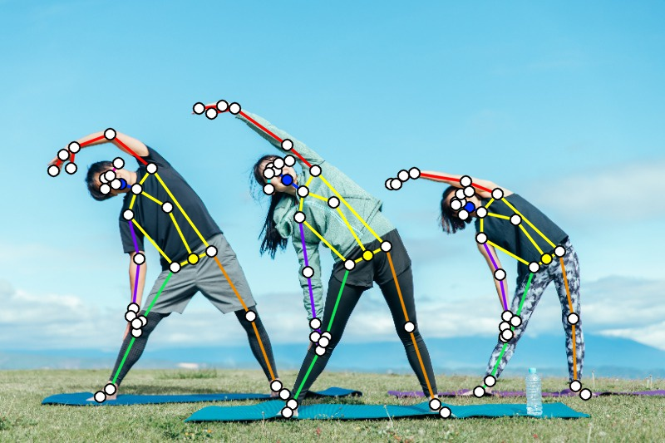
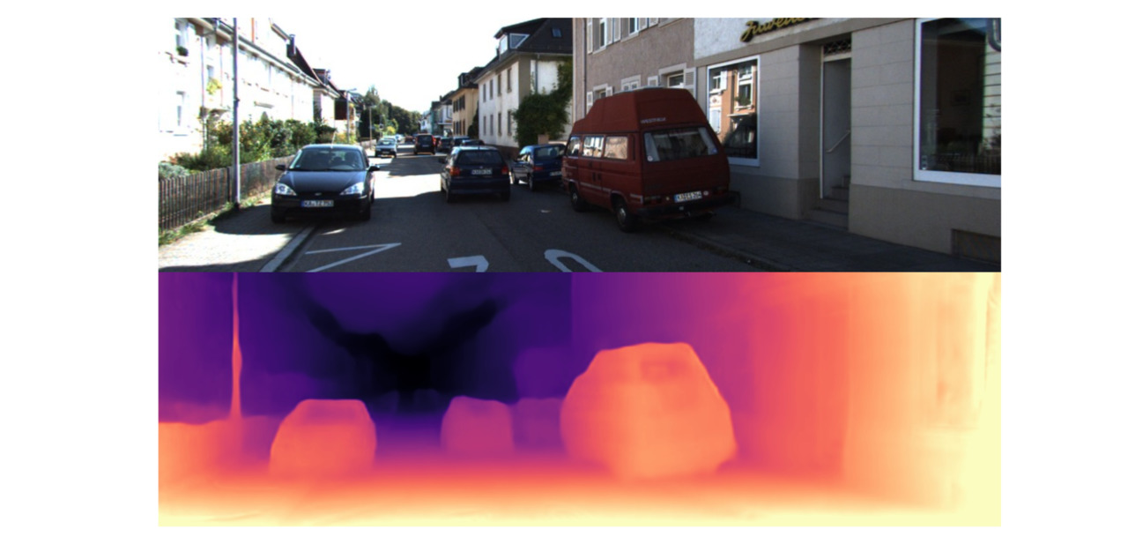
II. Related Deep learning problems
Key points detection
Semantic ill-defined key points
Research focus on detection rather than accuracy
Depth estimation
Not intended to achieve millimeter-level precision
Requires fully annotated datasets

Slide 8
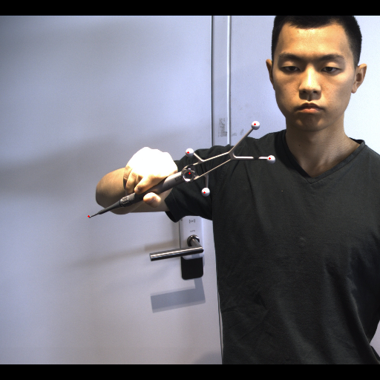
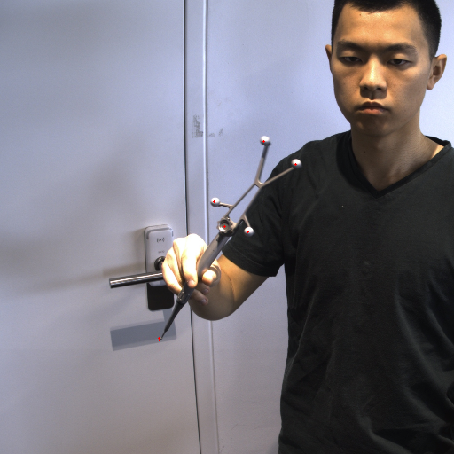
II. Pipeline overview
RGB images
2D key points detection
Deep learning based
Triangulation
3D transformation
Annotations come from manual calibration and projection

Slide 9
III. Diving into key points detection

Slide 10
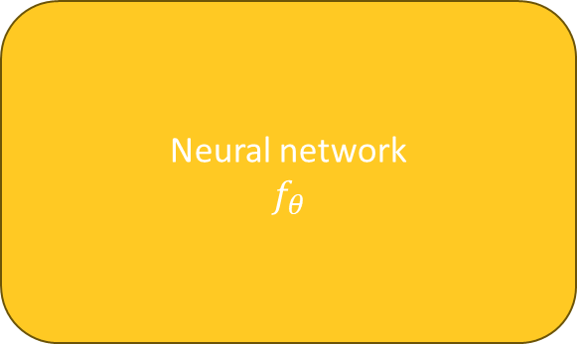
III. Basic understanding of Deep learning
Neural network
$$f_{θ}$$
Inputs:
512x512 images
Outputs:
Key points coordinates
(2,)
Annotations
Loss function
Training

Slide 11
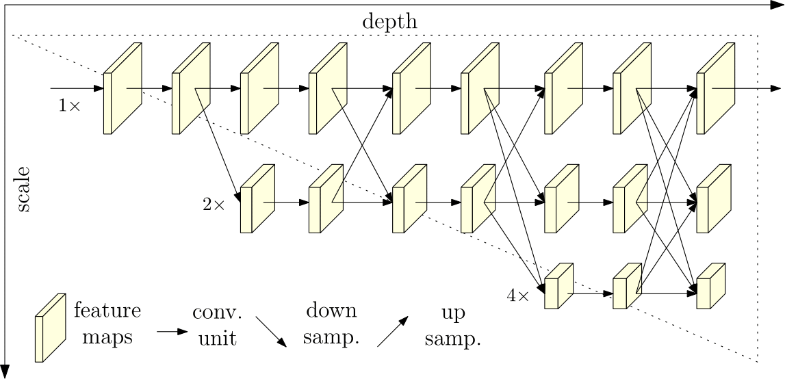
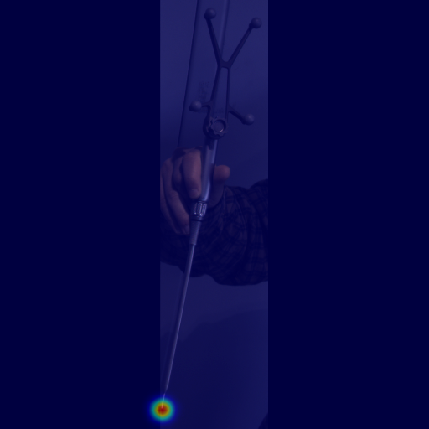
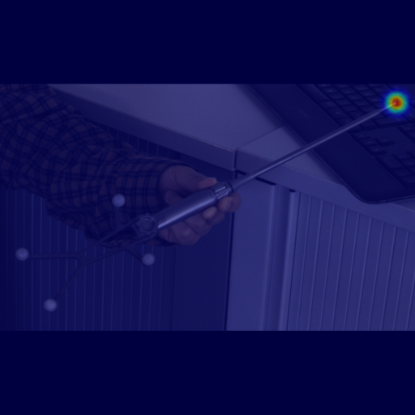
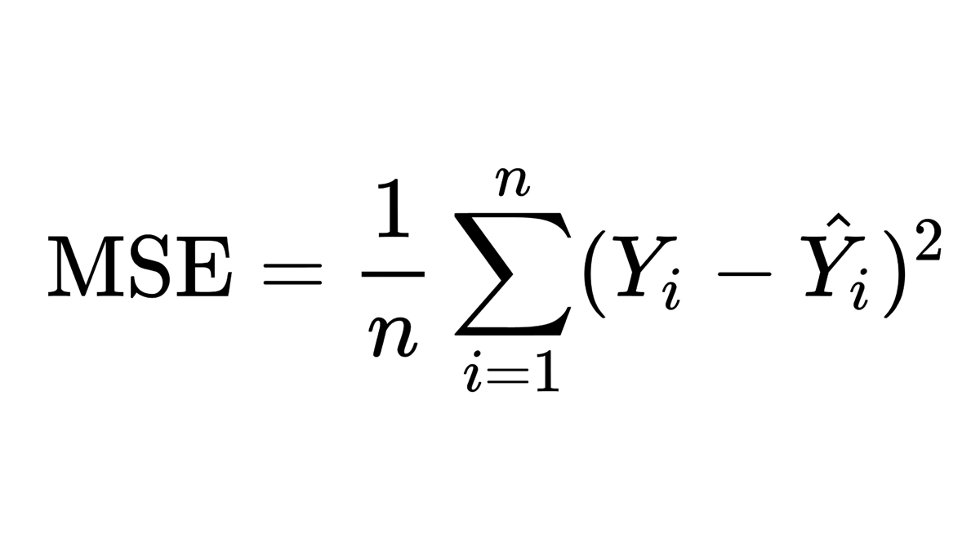
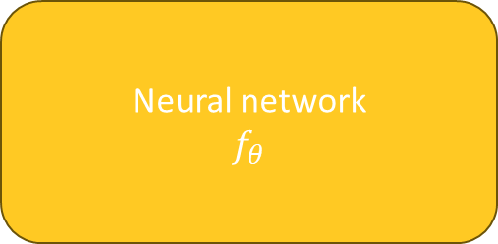
III. Implemented architecture
Neural network
$$f_{θ}$$
HRNet, one of the latest architecture in semantic key points detection
Excels in capturing the connections between local and global features
Outputs a Gaussian heatmap instead of coordinates
The output resolution is 4 times smaller on each dimension
Loss:

Slide 12
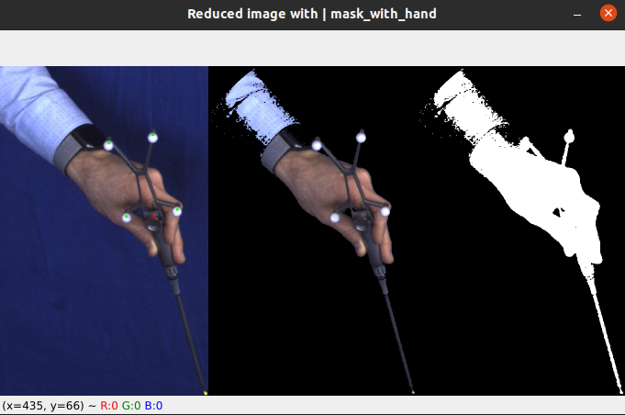
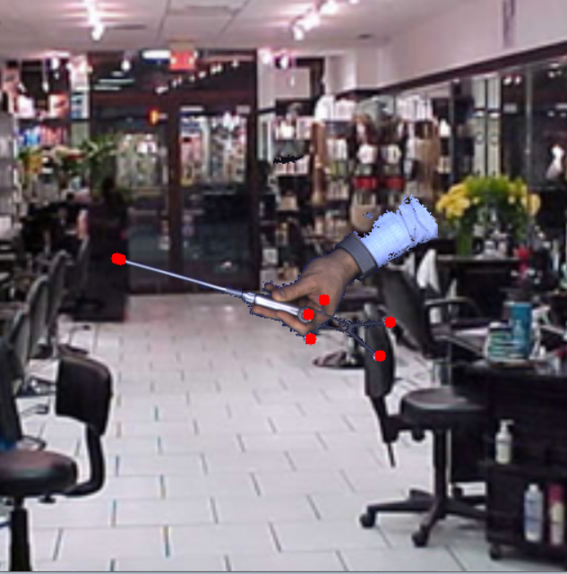
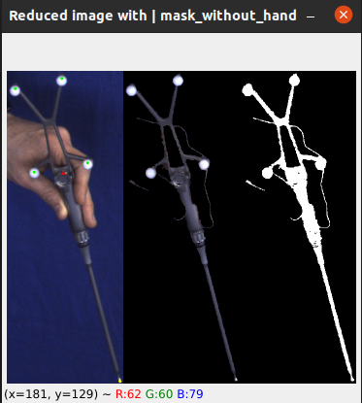
III. Increase diversity in the images
Train set: 1,047 images
Test set 645 images
Synthetic data generation from images taken in front of a blue drape to generate data with diverse background
Classic data augmentation: rotation, brightness and contrast, flipping, etc.

Slide 13
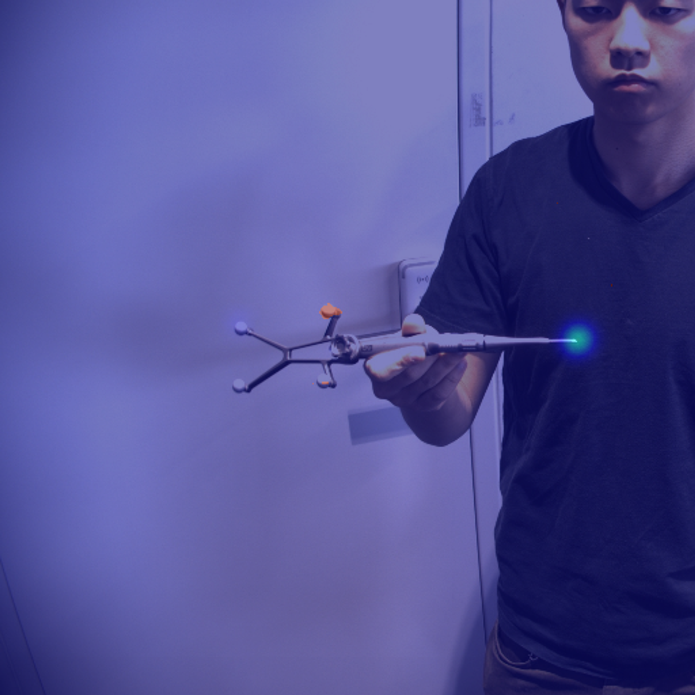
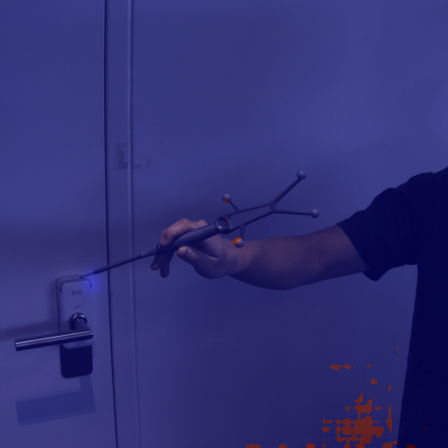
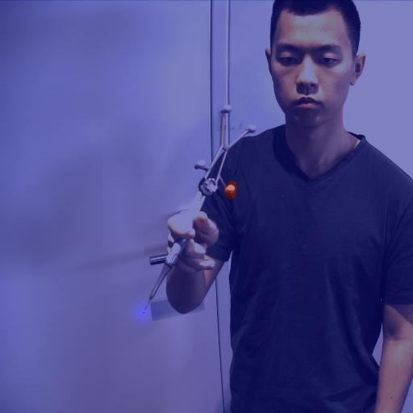
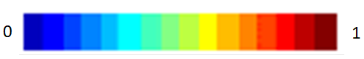
III. Postprocessing and confidence score
Coordinates are estimated from the argmax of the heatmap
The maximum value of the heatmap is a number between 0 and 1 and is used as a confidence score
A threshold can be used to discard images according to this confidence score

Slide 14
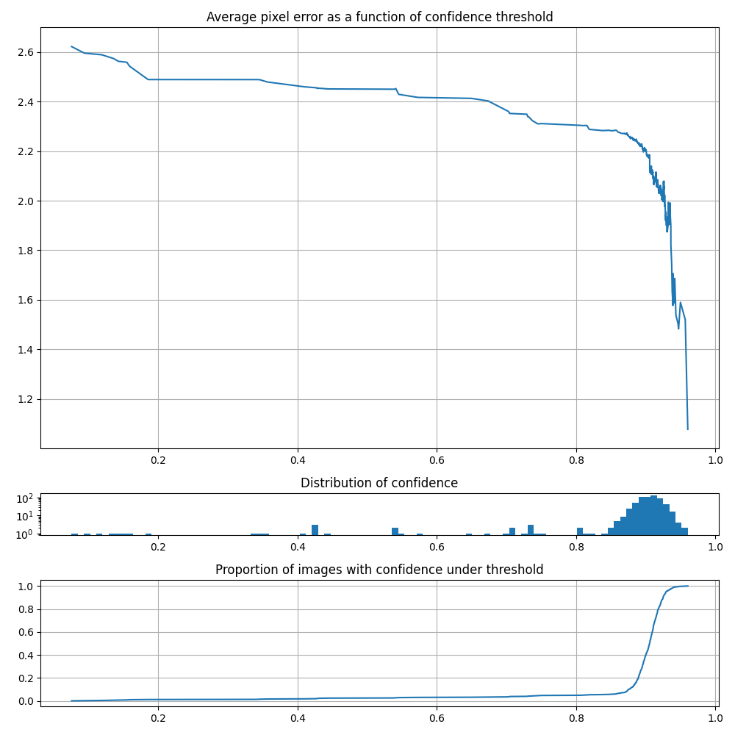
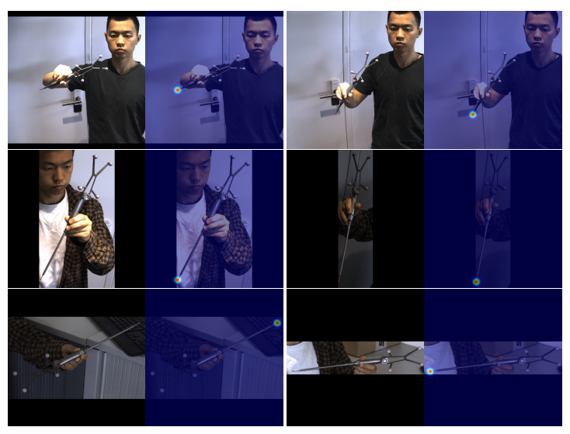
III. 2D Key points detection results
Random test samples visualization
Test set metrics

Slide 15
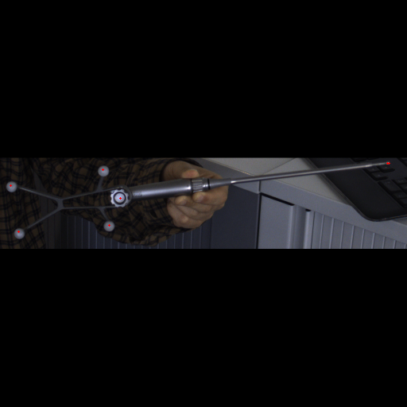
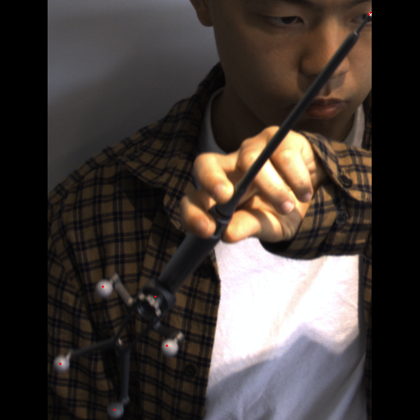
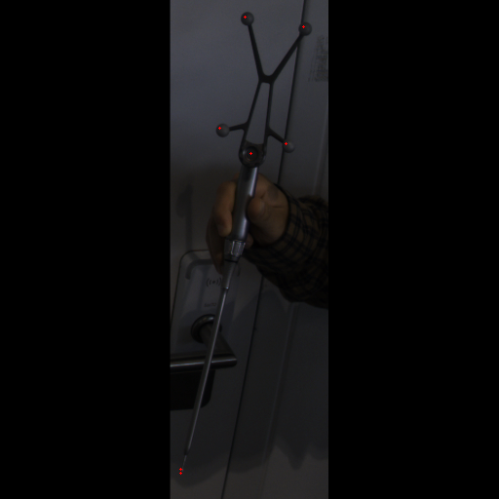
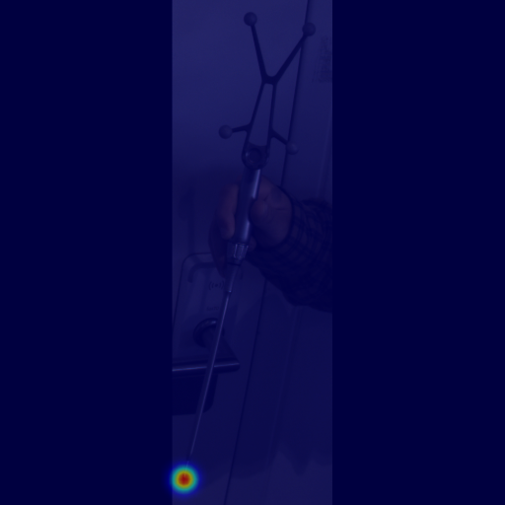
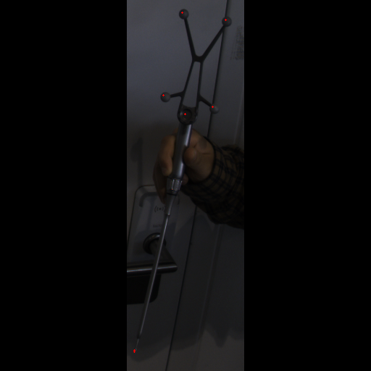
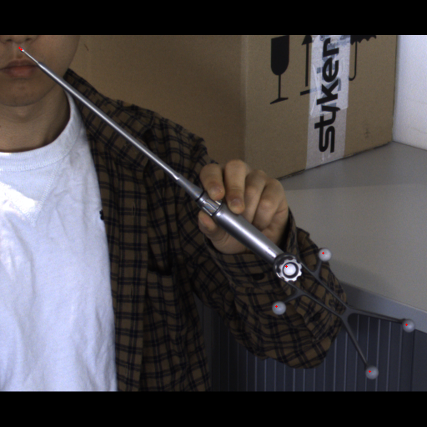
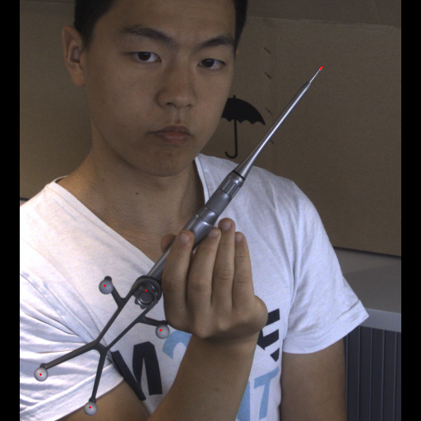
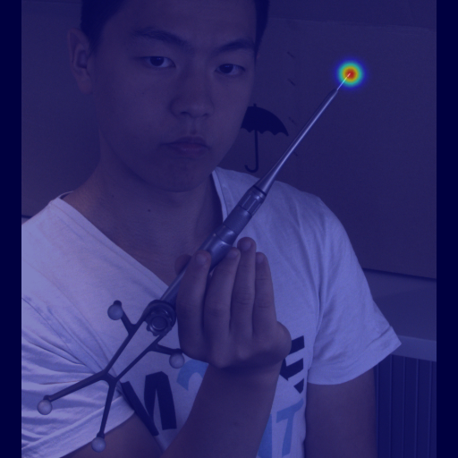
III. Qualitative analysis – Best samples

Slide 16
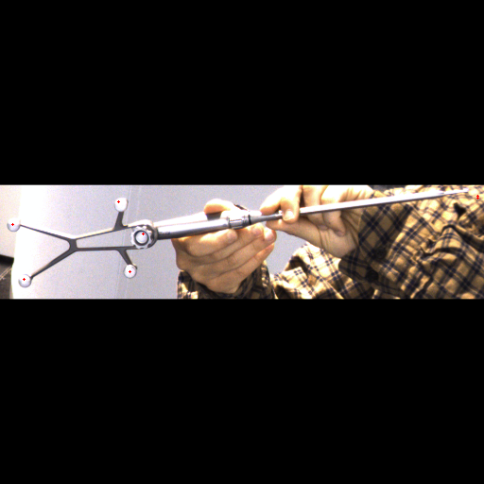
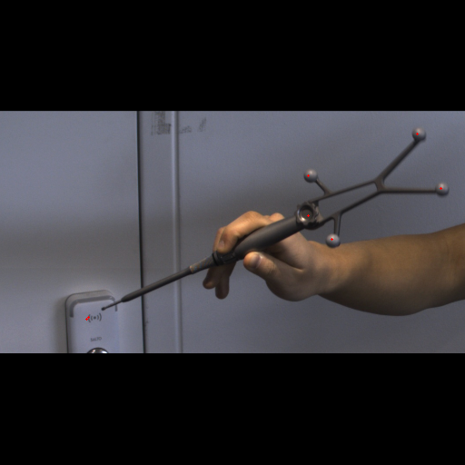
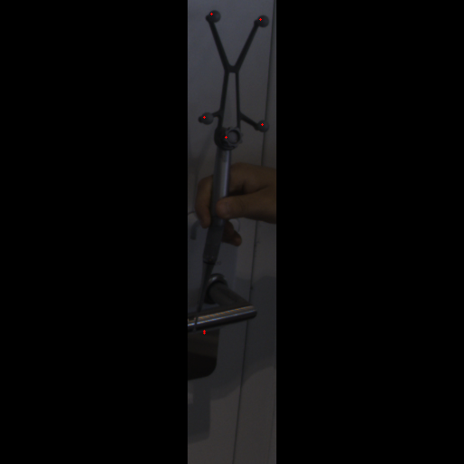
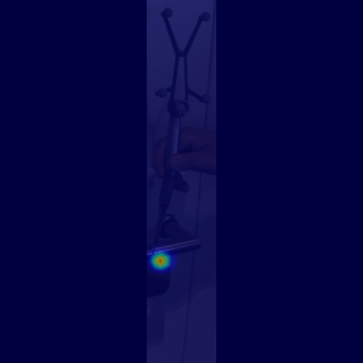
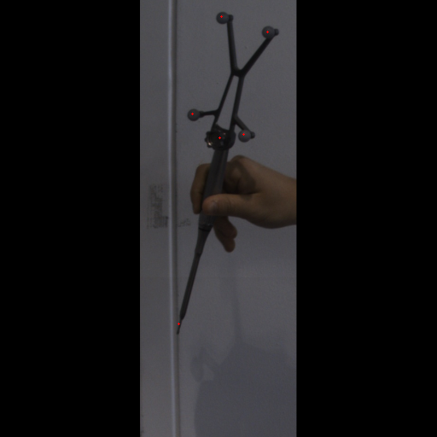
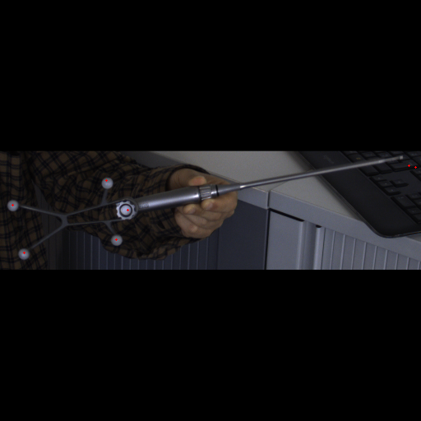
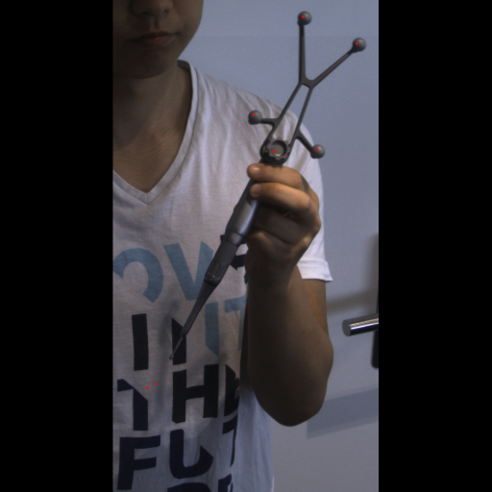
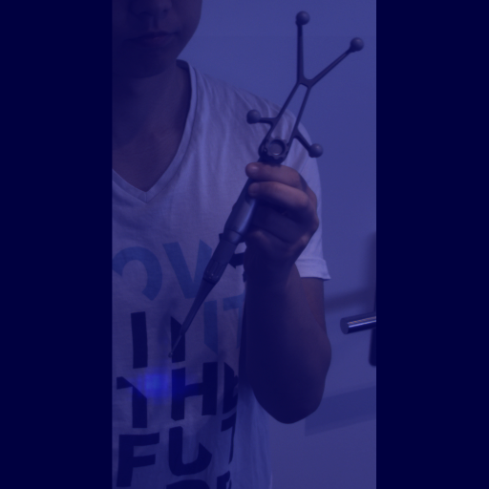
III. Qualitative analysis – Worst samples

Slide 17
IV. Triangulation through time

Slide 18
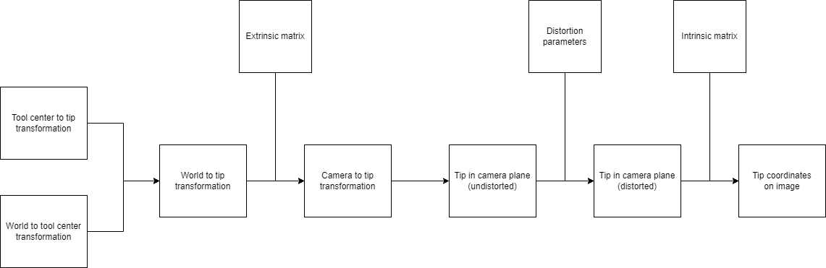
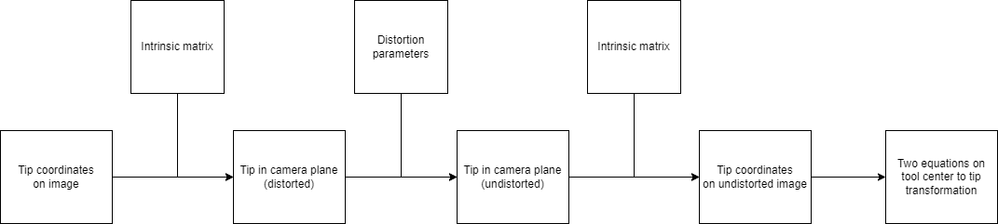
IV. Triangulation pipeline
Projection pipeline
Triangulation pipeline

Slide 19
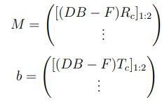
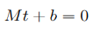
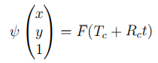
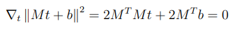
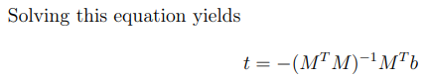
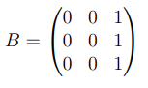
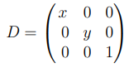
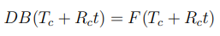

IV. Mathematical details
Instrument tracker rotation and translattion
Image coordinates
For an ideal case,
Unknown
Unknown 3D transformation
Intrinsic matrix
Let’s note
Each image constrains the tip to be on a line in the 3D space
With more than 2 lines we can get the tip by optimizing the coordinates to match all lines
Therefore
Last line is null so we have two constraining equations per image

Slide 20


IV. Results analysis
The more images the better
25 images after postprocessing yields an error of 3.0 mm
25 frames correspond to a video of 10 seconds

Slide 21
V. How to get better?

Slide 22


IV. Better annotations
Annotations are gathered from the previous calibation method which has an error up to 2 mm.
The projection error can go up to 5 pixels which might confuse the network during training
A series of experiments seem to point out that most of this error comes from the tracker’s positions

Slide 23

IV. Architecture limitations
The output resolution of the network offers a maximum precision of +/- 1 pixel
The input image is a resized one because of hardware limitation during training (0.5 factor in average)
A second network could be trained to refine the predictions of the first one

Slide 24
Thank you for your attention
Clement Wang
clementwang2001@gmail.com

